Slide 1
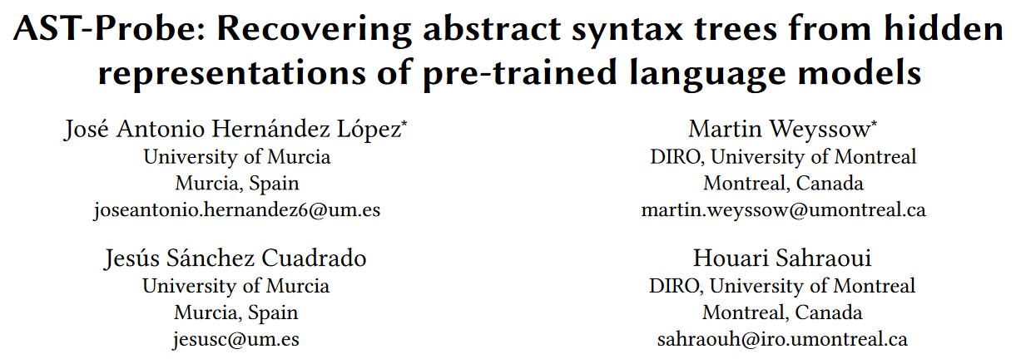
ASE 2022

Slide 2
Introduction
How well do pre-trained models understand the code?
To answer this question, we can analyze their hidden states.
In NLP, probing is used to find out whether hidden states encode specific linguistic properties.
Probe: a simple classifier that takes the hidden states as input and predicts a linguistic property of interest.
Some recent works have discovered some linguistic properties of the input code from the hidden states by using the probes.

Slide 3
Introduction
But we want to go one-step further, directly probing the whole AST.
In order to do that, we propose a novel probing approach called the AST-probe, which can predict the whole AST from hidden states.
We evaluate the AST-probe on 5 SOTA pre-trained language models and 3 programming languages to demonstrate its generalizability.
We further attempt to estimate how many dimensions are used by pre-trained models to store AST-related syntactic information.

Slide 4
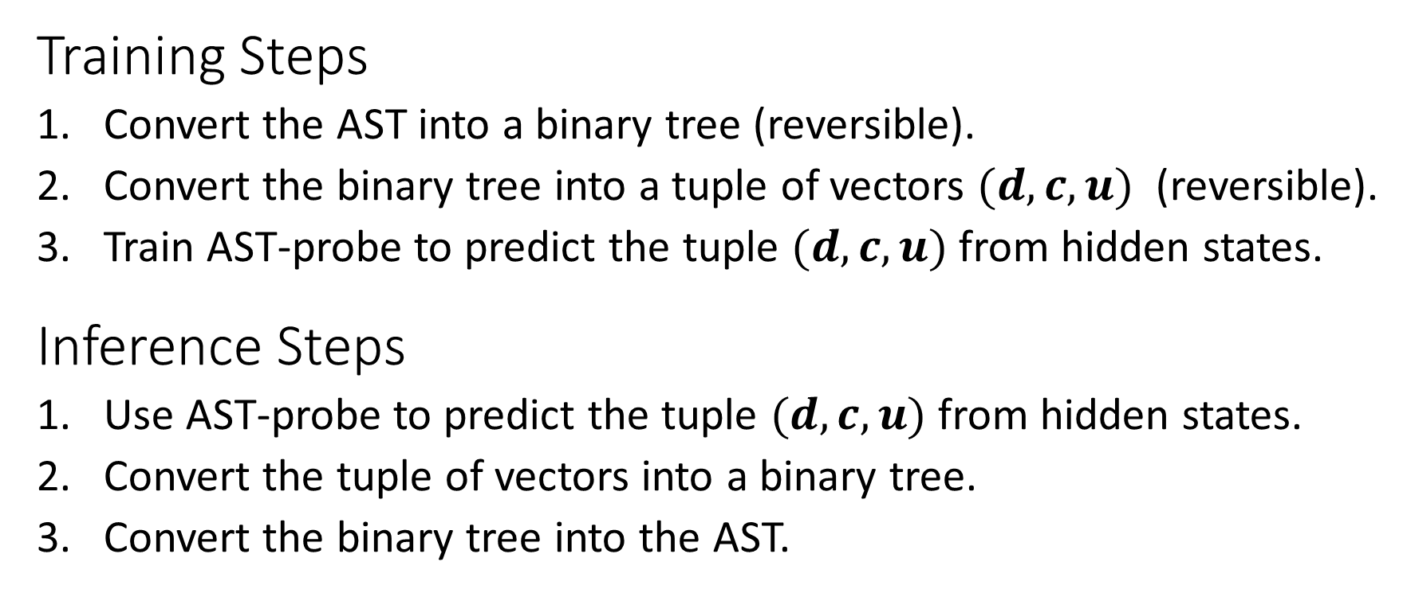
AST-Probe
Training Steps
Convert the AST into a binary tree (reversible).
Convert the binary tree into a tuple of vectors $(d, c, u)$ (reversible).
Train AST-probe to predict the tuple $(d, c, u)$ from hidden states.
Inference Steps
Use AST-probe to predict the tuple $(d, c, u)$ from hidden states.
Convert the tuple of vectors into a binary tree.
Convert the binary tree into the AST.

Slide 5
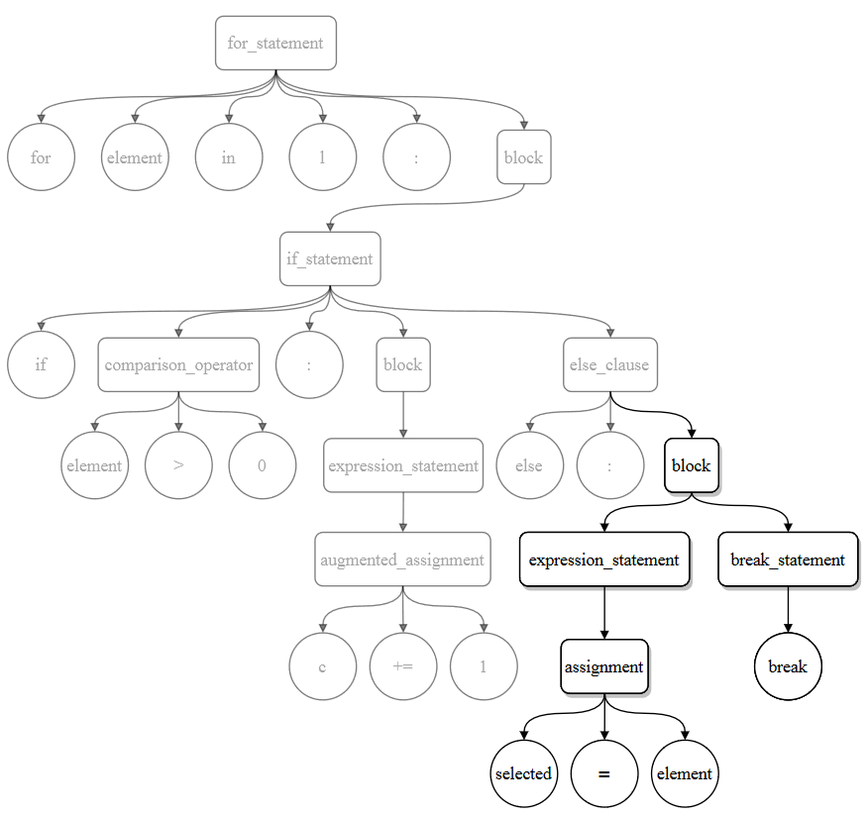
Example
Code AST
for element in l:
if element > 0:
c += 1
else:
selected = element
break

Slide 6
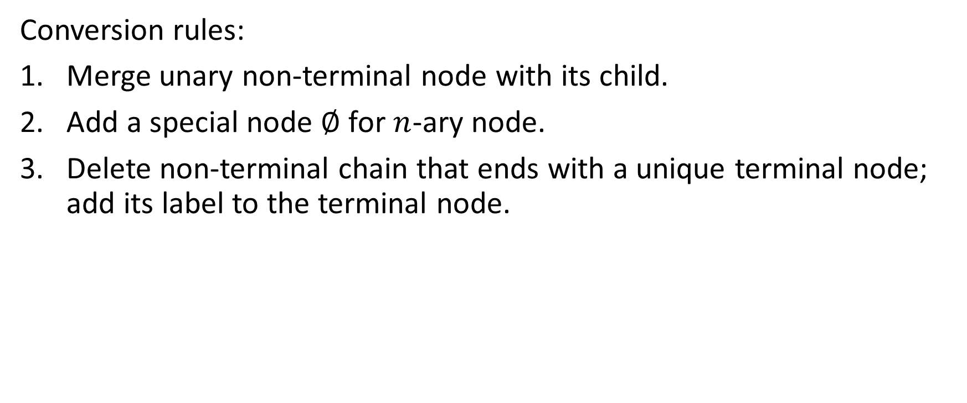
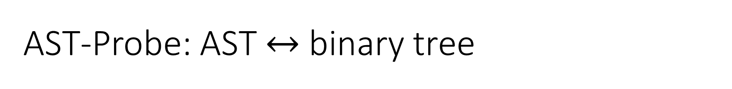
AST-Probe: AST $↔$ binary tree
Conversion rules:
Merge unary non-terminal node with its child.
Add a special node $∅$ for $n$-ary node.
Delete non-terminal chain that ends with a unique terminal node; add its label to the terminal node.

Slide 7
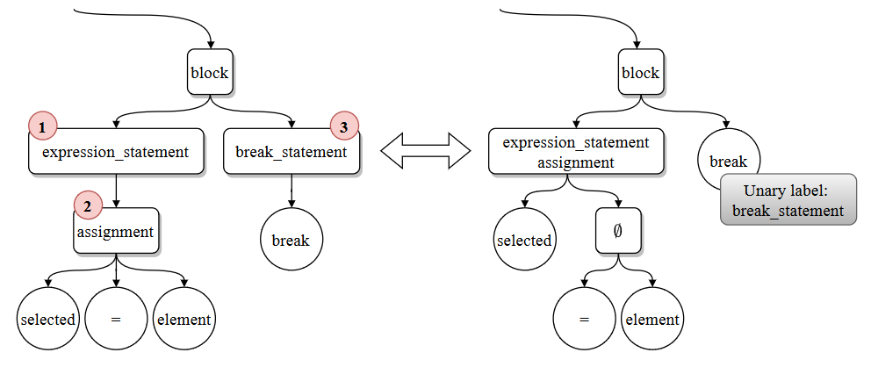
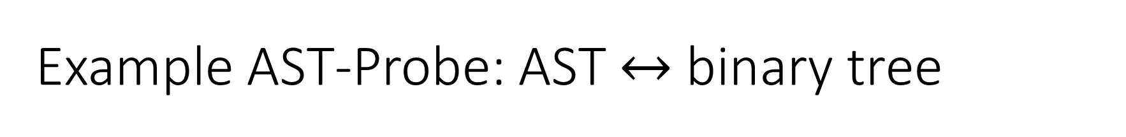
Example AST-Probe: AST $↔$ binary tree
Note that only the else block is shown in this figure.

Slide 8
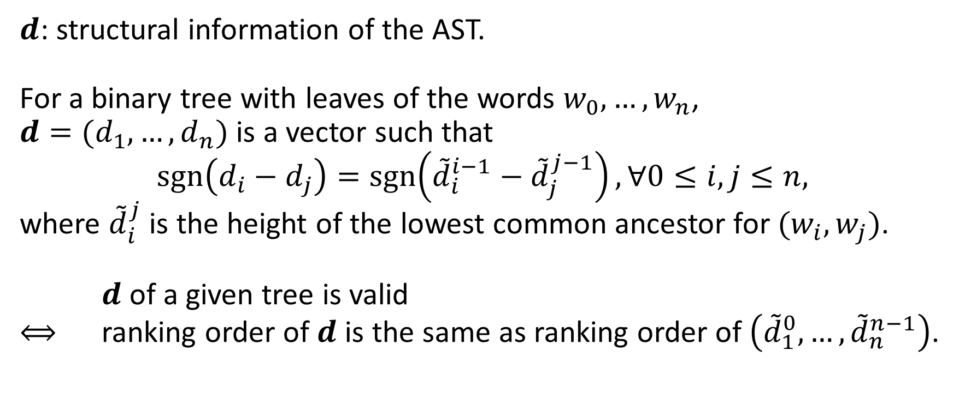
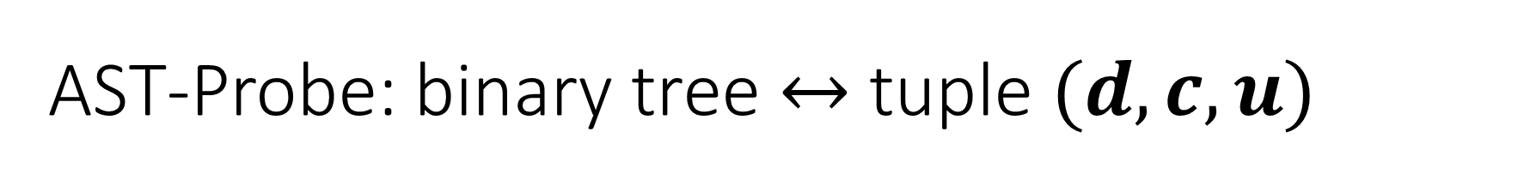
AST-Probe: binary tree $↔$ tuple $(d, c, u)$
$d$: structural information of the AST.
For a binary tree with leaves of the words $w_{0}, …,w_{n}$, $d=(d_{1},…,d_{n})$ is a vector such that $$\operatorname{sgn}\left(d_{i}−d_{j}\right)=\operatorname{sgn}\left({\tilde{d}}_{i}^{i−1}−{\tilde{d}}_{j}^{j−1}\right), ∀0≤i,j≤n,$$ where ${\tilde{d}}_{i}^{j}$ is the height of the lowest common ancestor for $(w_{i},w_{j})$.
$d$ of a given tree is valid $⟺$ ranking order of $d$ is the same as ranking order of $\left({\tilde{d}}_{1}^{0},…,{\tilde{d}}_{n}^{n−1}\right)$.

Slide 9
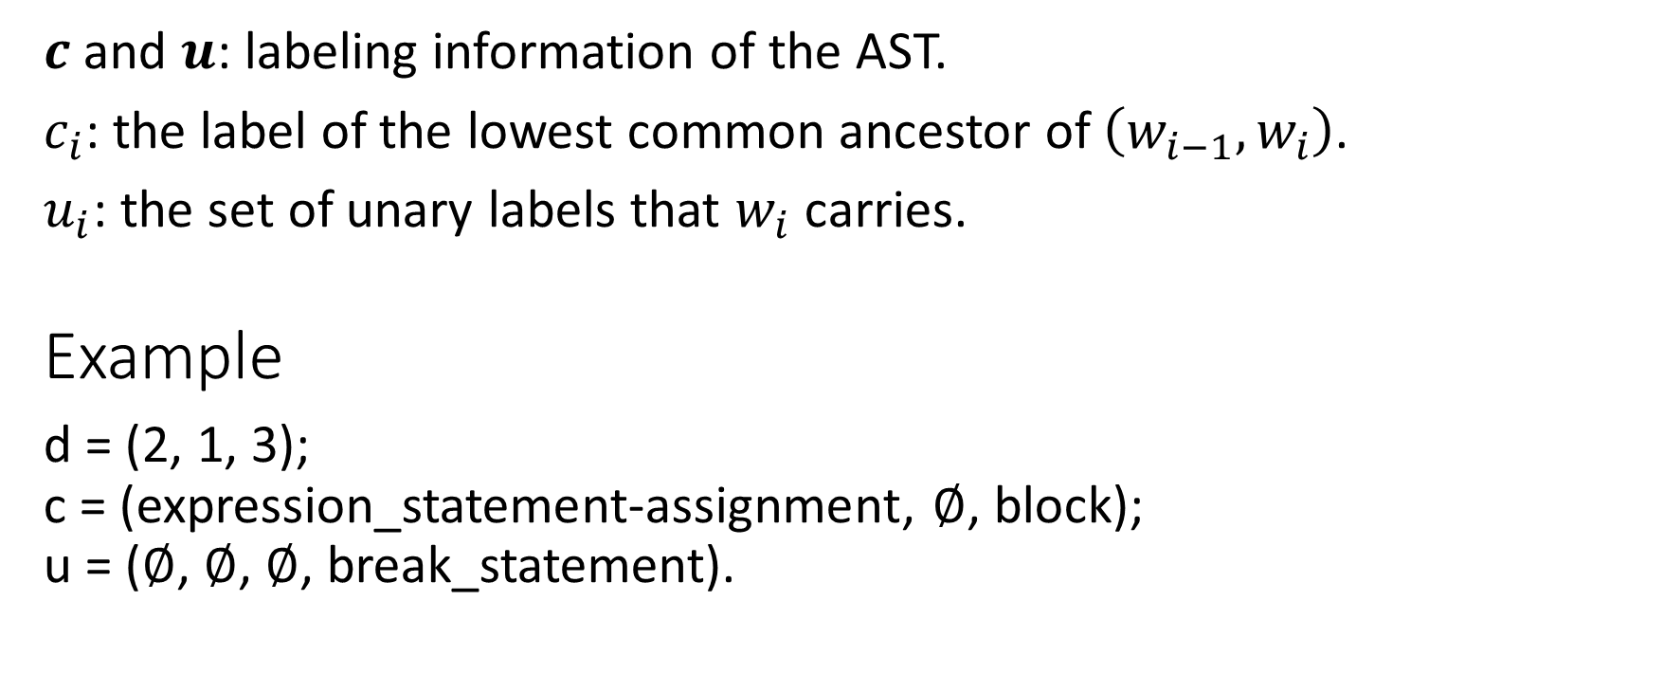
AST-Probe: binary tree $↔$ tuple $(d, c, u)$
$c$ and $u$: labeling information of the AST.
$c_{i}$: the label of the lowest common ancestor of $\left(w_{i−1},w_{i}\right)$.
$u_{i}$: the set of unary labels that $w_{i}$ carries.
Example
d = (2, 1, 3); c = (expression_statement-assignment, $∅$, block); u = ($∅$, $∅$, $∅$, break_statement).

Slide 10
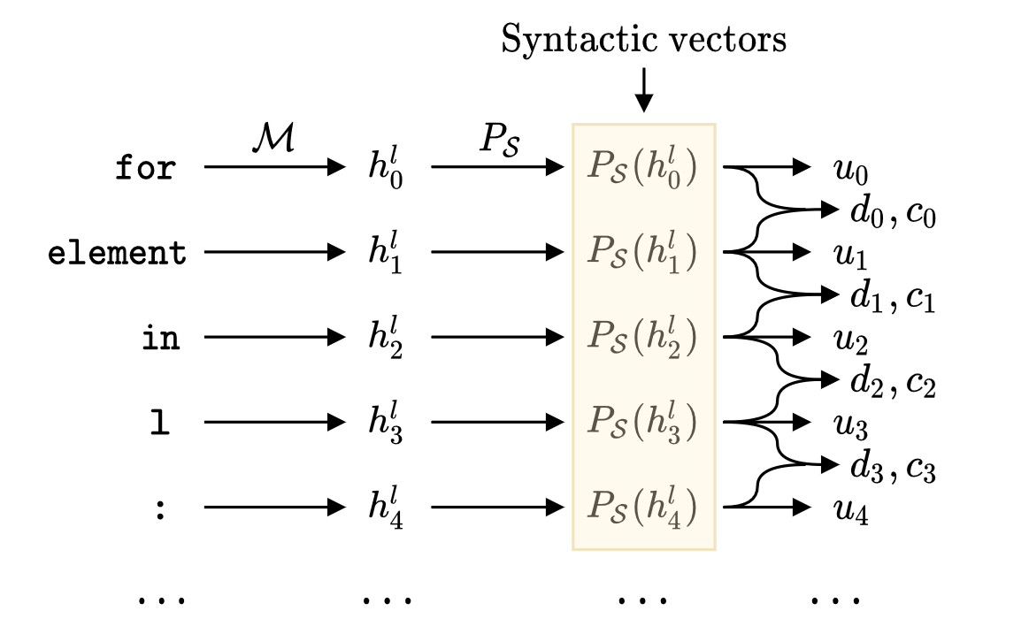

AST-Probe
We denote $h_{0},…,h_{n}∈ℝ^{m_{1}}$ as the hidden states of input tokens.
Our hypothesis is that there exists a syntactic subspace $𝒮⊆ℝ^{m_{1}}$ that encodes the AST information, so the AST-probe will learn a syntactic subspace $𝒮$.

Slide 11
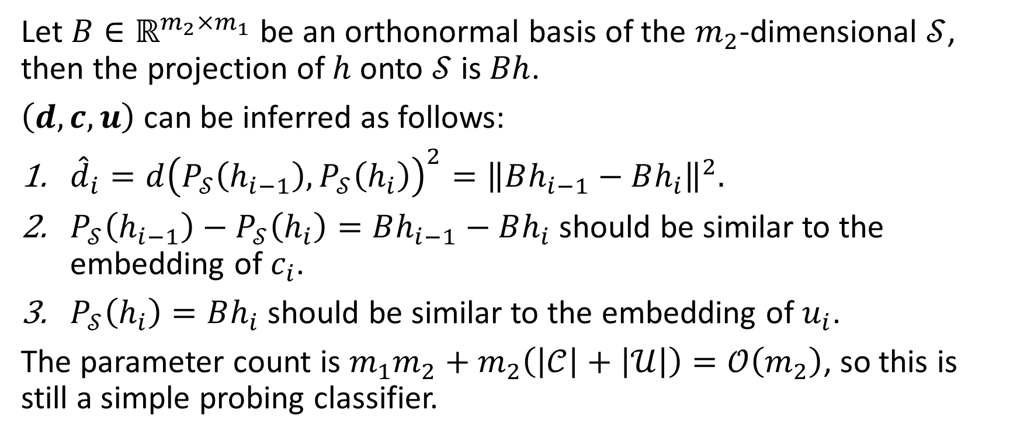
AST-Probe
Let $B∈ℝ^{m_{2}×m_{1}}$ be an orthonormal basis of the $m_{2}$-dimensional $𝒮$, then the projection of $h$ onto $𝒮$ is $Bh$.
$\left(d, c, u\right)$ can be inferred as follows:
${\hat{d}}_{i}=d{\left(P_{𝒮}\left(h_{i−1}\right),P_{𝒮}\left(h_{i}\right)\right)}^{2}={\left\|Bh_{i−1}−Bh_{i}\right\|}^{2}.$
$P_{𝒮}\left(h_{i−1}\right)−P_{𝒮}\left(h_{i}\right)=Bh_{i−1}−Bh_{i}$ should be similar to the embedding of $c_{i}$.
$P_{𝒮}\left(h_{i}\right)=Bh_{i}$ should be similar to the embedding of $u_{i}$.
The parameter count is $m_{1}m_{2}+m_{2}\left(\left|𝒞\right|+\left|𝒰\right|\right)=𝒪\left(m_{2}\right)$, so this is still a simple probing classifier.

Slide 12
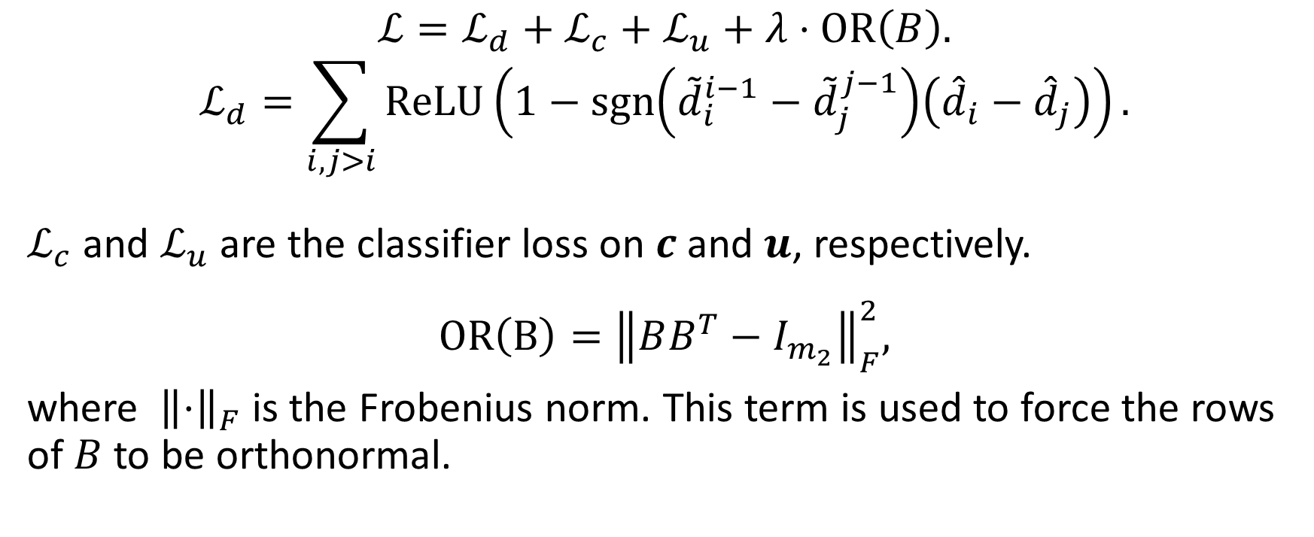
AST-Probe: Loss
$$ℒ=ℒ_{d}+ℒ_{c}+ℒ_{u}+λ⋅OR\left(B\right).$$
$$ℒ_{d}=\sum_{i,j>i}{ReLU}\left(1−\operatorname{sgn}\left({\tilde{d}}_{i}^{i−1}−{\tilde{d}}_{j}^{j−1}\right)\left({\hat{d}}_{i}−{\hat{d}}_{j}\right)\right).$$
$ℒ_{c}$ and $ℒ_{u}$ are the classifier loss on $c$ and $u$, respectively.
$$OR\left(B\right)={\left\|BB^{T}−I_{m_{2}}\right\|}_{F}^{2},$$
where ${\left\|⋅\right\|}_{F}$ is the Frobenius norm. This term is used to force the rows of $B$ to be orthonormal.

Slide 13
Experiments: Setup
Data
20k/2k/4k subsets of CodeSearchNet Python & Go & Javascript.
ASTs parsed by tree-sitter.
Metrics
Precision, recall and F1 over tree constituents.
Constituent: (non-terminal, span).

Slide 14
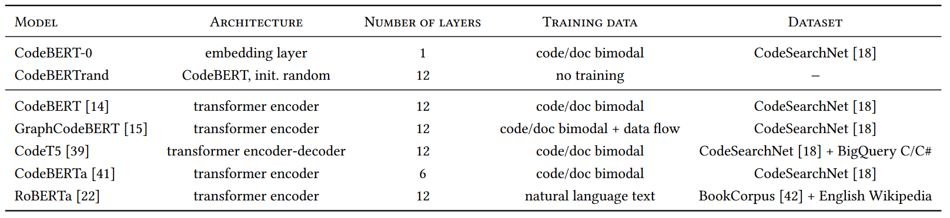
Experiments: Setup
Models

Slide 15
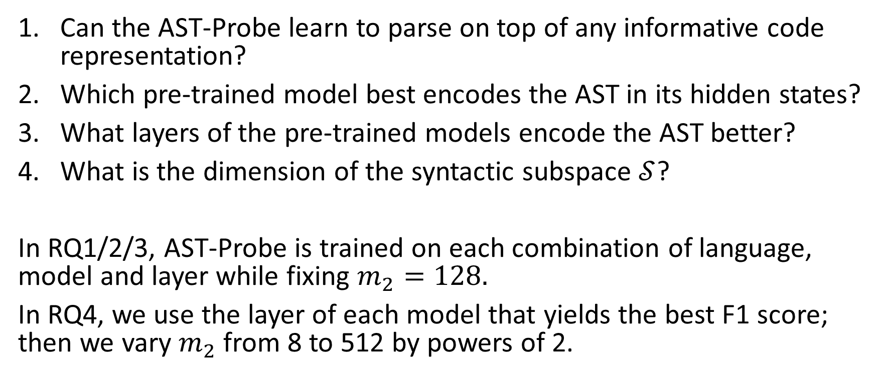
Experiments: Research Questions
Can the AST-Probe learn to parse on top of any informative code representation?
Which pre-trained model best encodes the AST in its hidden states?
What layers of the pre-trained models encode the AST better?
What is the dimension of the syntactic subspace $𝒮$?
In RQ1/2/3, AST-Probe is trained on each combination of language, model and layer while fixing $m_{2}=128.$
In RQ4, we use the layer of each model that yields the best F1 score; then we vary $m_{2}$ from 8 to 512 by powers of 2.

Slide 16
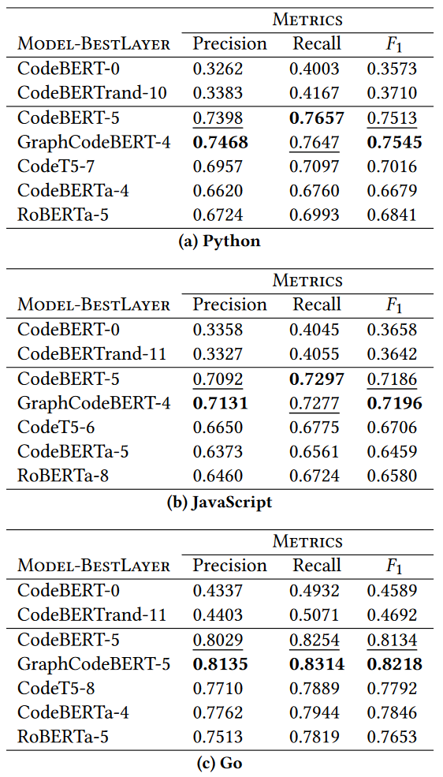
Results
RQ1: Validity of AST-Probe
There is a significant gap between the baselines and the real models.
So AST-Probe is unable to learn to generate the AST by itself, thus valid.

Slide 17
Results
RQ2: Best model
Overall (F1), CodeBERT and GraphCodeBERT.
RoBERTa is competitive - why?

Slide 18
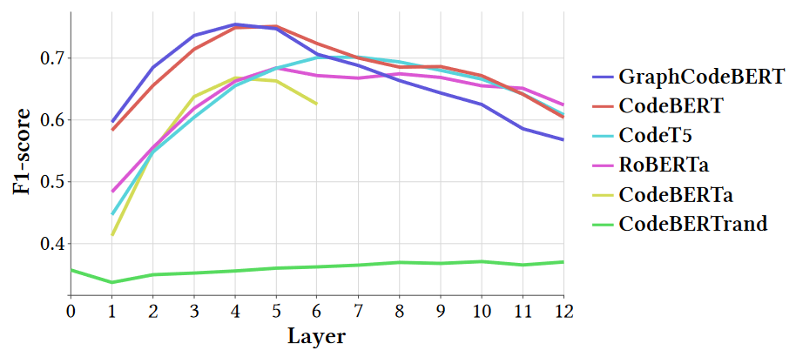
Results
RQ3: Best layers
Roberta: 5 & 8;
CodeT5: 6 - 7 - 8;
CodeBERT & GraphCodeBERT & CodeBERTa: 4 - 5.

Slide 19
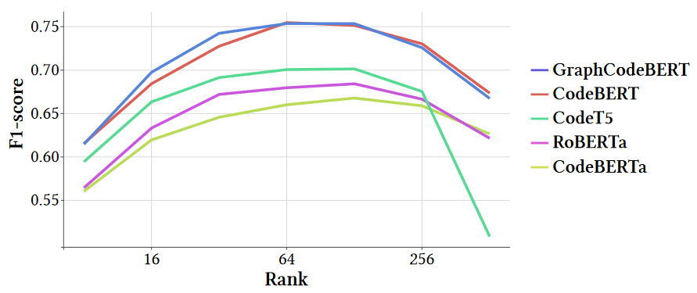

Results
RQ4: Estimating the dimension of $𝒮$
Between 64 and 128, only a small part of the full dimensions, 768.

Slide 20
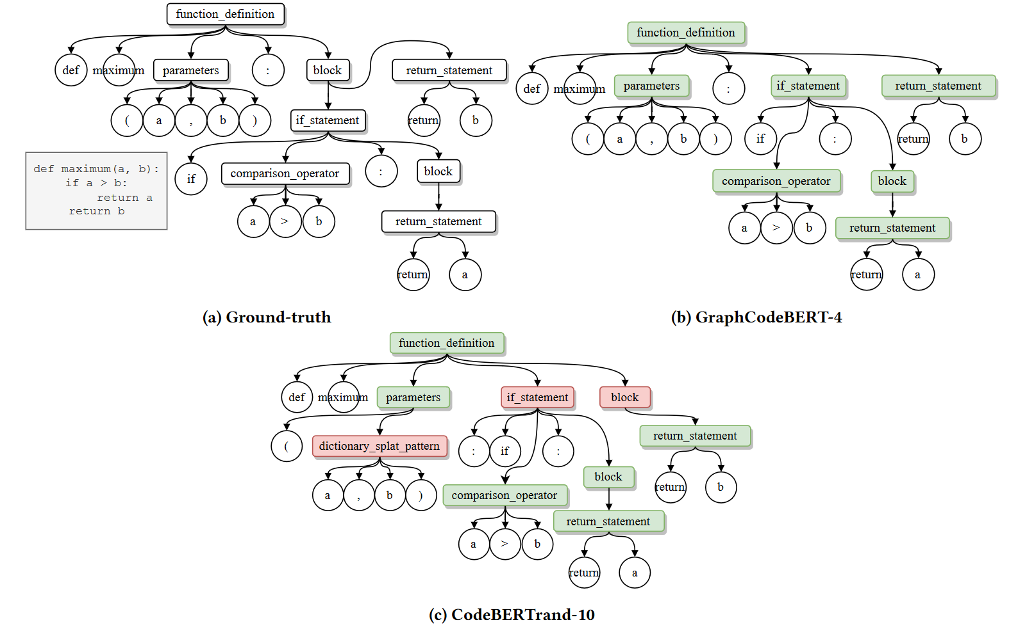
Case Study

Slide 21
Conclusion
AST-Probe can recover the whole AST from hidden states of pre-trained models.
About 64-128 dimensions are used by pre-trained models to store AST-related syntactic information.

